Slide 1
Data Management
Learning Goals:
Interpret and evaluate data in tables and graphs
Draw labelled graphs by hand and with a computer

Slide 2
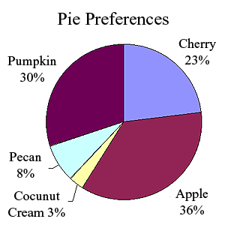
Circle Graph (Pie Chart)
Displays data using a circle divided into sectors. We use a circle graph (also called a pie chart) to show how data represent portions of one whole or one group. Notice that each sector is represented by %

Slide 3
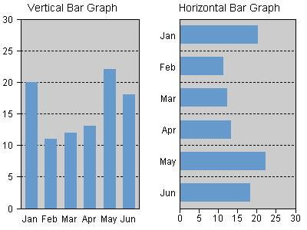
Bar Graph
Displays data by using bars of equal width on a grid. The bars may be vertical or horizontal. Bar graphs are used for comparisons.

Slide 4
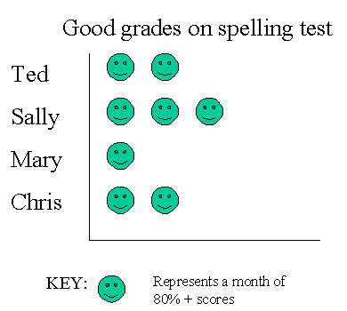
Pictograph
Uses pictures and symbols to display data; each picture or symbol can represent more than one object; a key tells what each picture represents.

Slide 5
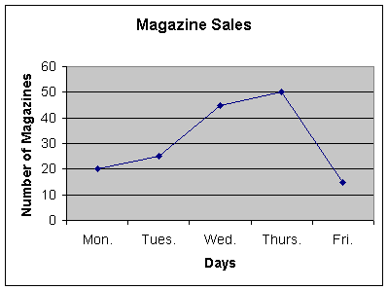
Broken Line Graph
A graph showing data points joined by line segments to show trends over time.

Slide 6
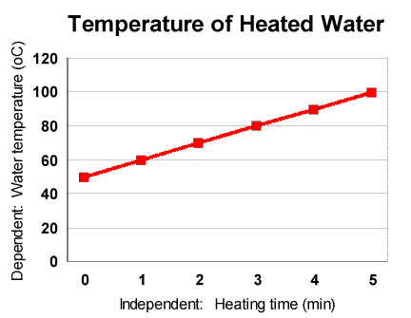
Continuous Line Graph
A graph in which points on the line between the plotted points also have meaning. Sometimes, this is a “best fit” graph where a straight line is drawn to fit the data points. Notice that the independent variable is on the X axis, & the dependent is on the Y axis.

Slide 7
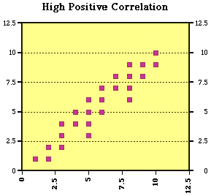
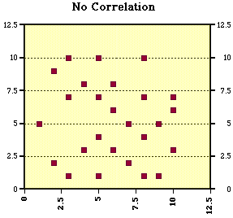
Scatter Plots
A graph of data that is a set of points.

Slide 8
Sample Question #1
Mrs. Ashby has a math class with 23 students. She ordered the marks her students received from the least to the greatest.
She wanted to display these data in a bar graph.
There were too many pieces of data to graph each mark separately. First, he grouped the marks into equal intervals. (Define)
54 | 55 | 58
61 | 63 | 66
67 | 71 | 72
72 | 74 | 76
77 | 78 | 79
81 | 86 | 87
88 | 91 | 95
95 | 99

Slide 9

Marks | # of Students
54 | 55 | 58
61 | 63 | 66
67 | 71 | 72
72 | 74 | 76
77 | 78 | 79
81 | 86 | 87
88 | 91 | 95
95 | 99

Slide 10
Sample Question #2
Jackie and Vidhu recorded the average monthly temperatures in their towns for 8 months.
 | May | June | July | Aug. | Sept. | Oct. | Nov. | Dec.
Jackie’s town | 13°C | 18°C | 23°C | 20°C | 15°C | 9°C | 2°C | 0°C
Vidhu’s town | 18°C | 21°C | 23°C | 23°C | 18°C | 14°C | 9°C | 5°C
What kind of graph should we display the data for each town? Circle, Bar, Line, Pictograph, Scatterplots? Should we put both sets of data on the same grid? Should we use a different color for each town?
Is the average monthly temperature in Vidhu’s town always higher than in Jackie’s town? How can you tell this from the graph?
Write a statement about what the graph shows for each town.
Write two questions that can be answered using your graph.

